Slide 1
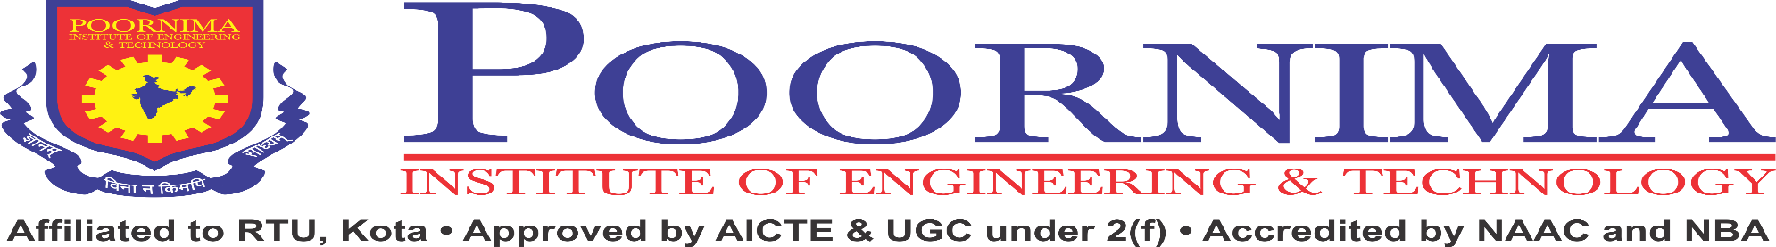

Department of Artificial Intelligence & Data Science
Main Presentation
Under
Industrial Training Presentation(5AID7-30)
Session-2023-24(Odd)
Presented by
Student Name: Naitik Pareek
Registration No.:PIET21AD030
Section: E
Presented to
Faculty Name: Mr. Kamal Saini
Faculty Name: Ms. Shiwangi Sharma

Slide 2
Content to be delivered :
Project Title
Project Objective
Project Technology(Frontend/Backend)
Project Modules
Project Demonstration
Project Learning Outcome
Conclusion and Future Plans
Digital Certificate

Slide 3
Industrial Training - MAIN Presentation
POORNIMA INSTITUTE OF ENGINEERING & TECHNOLOGY, JAIPUR
Department of Artificial Intelligence and Data Science
INDUSTRIAL TRAINING PRESENTATION
ON
Demand Forecasting using Machine Learning
SESSION 2023-24

Slide 4
Demand Forecasting Using Machine Learning
OBJECTIVE
Develop a demand forecasting model that accurately predicts product demand across different time periods
Utilize time series analysis, regression modeling, and feature engineering techniques to improve prediction accuracy.
Incorporate historical sales data, promotional events, seasonal variations, and economic indicators to capture demand factors.
Improve supply chain efficiency and retail profitability through optimized inventory planning.

Slide 5
Demand Forecasting Using Machine Learning
We're focused on delivering
Data-Driven insights.
Efficiency and Productivity.
Continuous Improvement.

Slide 6
Project Technology
Programming Language: Python for application logic.
Data Analysis and Visualization: Libraries used for Data analysis and visualization for sales related data.
Machine Learning: This technique is employed to analyze real time sales data and extract relevant information such as past production and sales.

Slide 7
Project Modules and Libraries
Matplotlib
Library for data visualization.
Used for data analysis and research.
Ideal for data exploration and research sharing.
Numpy and Pandas
To organize and structure the data in arrays and data frames.
Pandas is mainly used for data analysis.
Numpy facilitate efficient numerical operations on large data.
SkLearn
Its most robust and useful library for machine learning.
Provides efficient tools for statistical modeling.
Used for Classification, Regression and Dimensionality reduction.

Slide 8
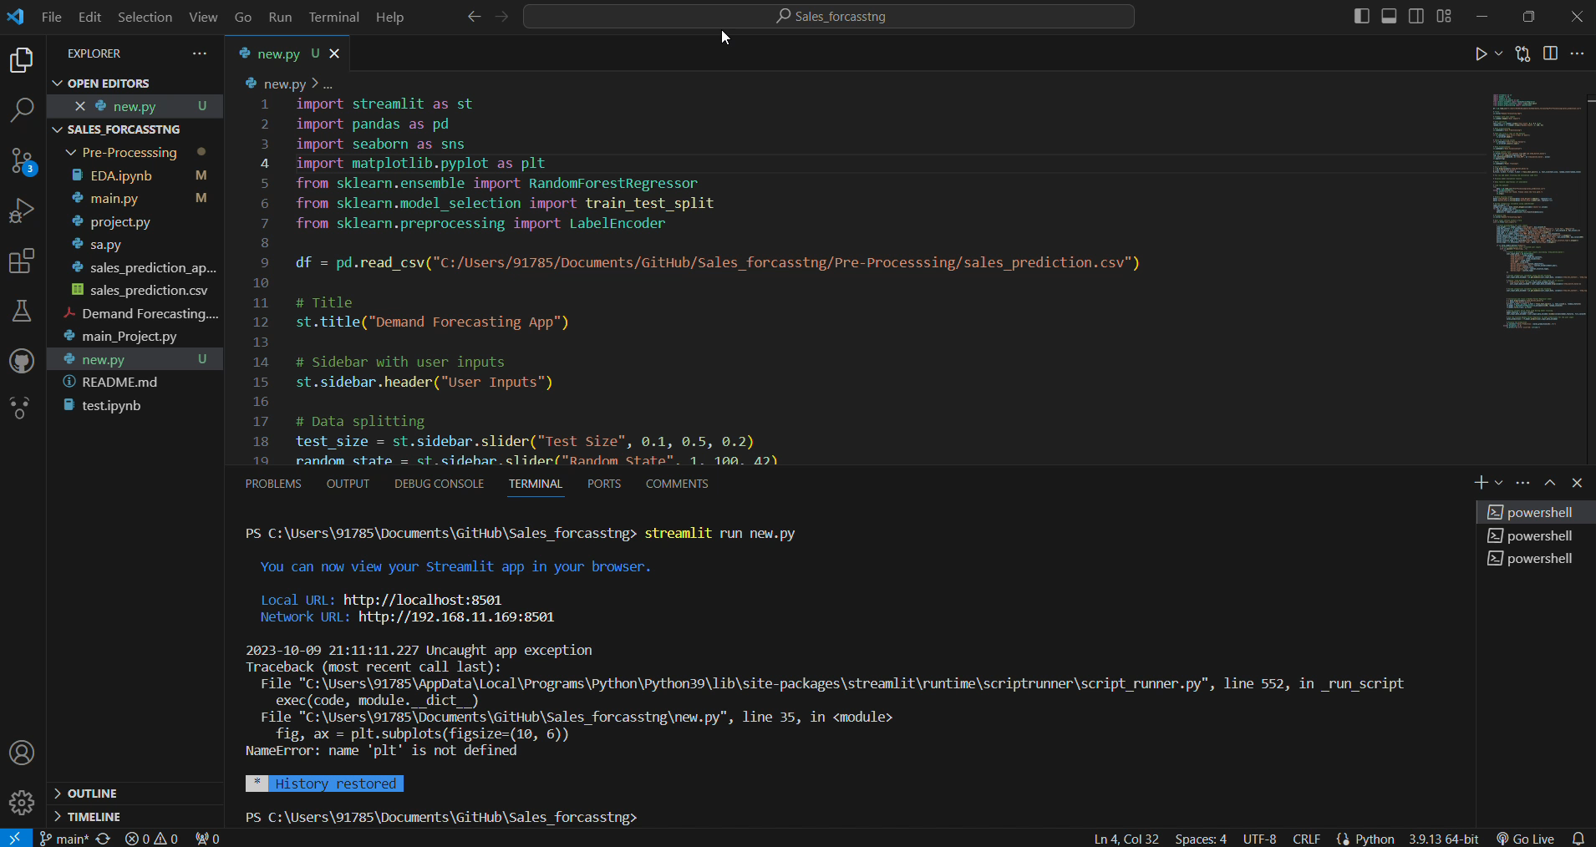
Project Demonstration

Slide 9
Project Learning Outcome
Gain proficiency in Python and Machine Learning.
Develop expertise in utilizing data analysis and visualization libraries such as NumPy, Pandas and Matplotlib.
Learn project planning and execution methodologies.
Understand and address specific challenges.
Hone presentation and communication skills for effectively conveying project concepts and findings.
Learn to present technical information to both technical and non-technical audiences in Jupyter Notebook.

Slide 10
Conclusion
In conclusion, the Demand Forecasting project presents an innovative solution for tackling sales past data and enhancing productivity and maximizing the profit. By leveraging data analysis, and predictive modeling, this system offers sales insights, requirement suggestions, and many more graph and charts to tackle the demand forecasting in E-Commerce market.

Slide 11
Future Plans
Predictive Maintenance: Integrate demand forecasts with predictive maintenance for optimized resource allocation.
Customized Forecasting Solutions: Tailor forecasting models for specific industries or product categories.
Implement advanced deep learning models.
Global Expansion: Apply forecasting solutions to international markets
Extend forecasting capabilities to predict demand in related industries.

Slide 12
Digital Certificate

Slide 13
Thanks
&
Query

